Slide 1
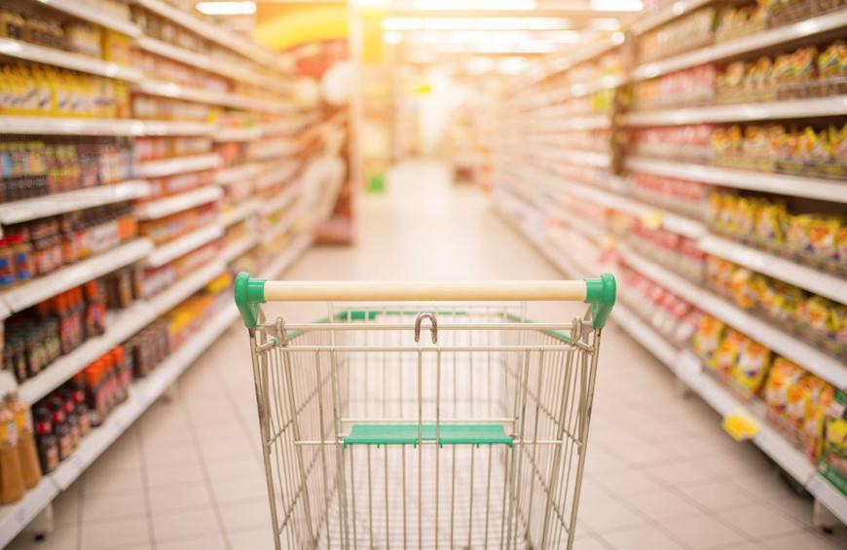
Marketing & Retail Analysis
Marketing & Retail Analysis
Milestone Project 2
-Prajoth
March 2022

Slide 2
Content:
Problem Statement
Exploratory Data Analysis
Market Basket Analysis
Association Rules
Example of Associate Rules
Threshold values of Support and Confidence:
KNIME workflow Image
Business Recommendation

Slide 3
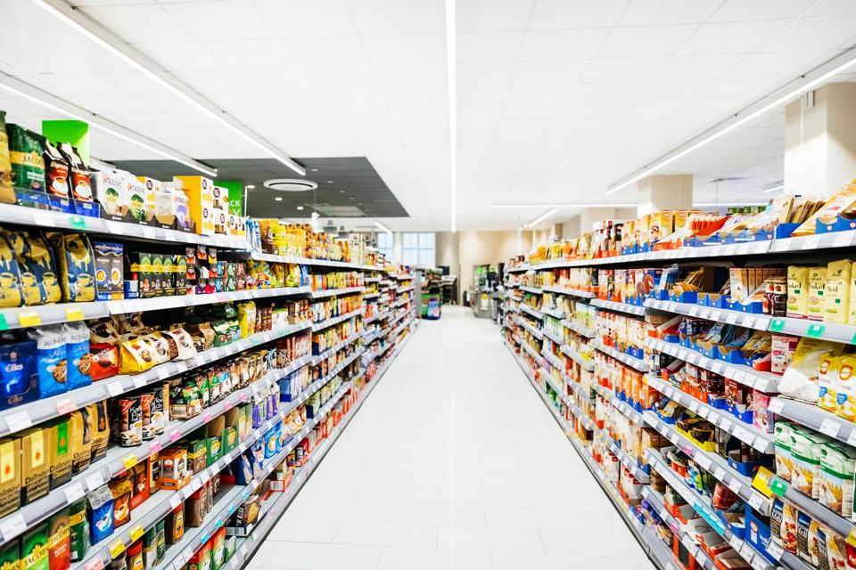
Problem Statement:
A Grocery Store shared the transactional data with you. Your job is to identify the most popular combos that can be suggested to the Grocery Store chain after a thorough analysis of the most commonly occurring sets of items in the customer orders. The Store doesn’t have any combo offers. Can you suggest the best combos & offers?

Slide 4
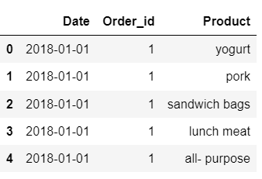
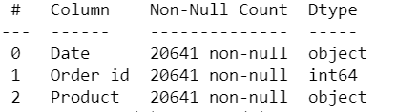
Exploratory Data Analysis:
Dataset has 20641 rows and 3 columns.
Dataset has both numerical and categorical variables.
Date ,Product are object type and order_id are integer type.
There is no null Values in dataset
Dataset has 4730 duplicate values. We removing the duplicates from dataset for better model performance.

Slide 5
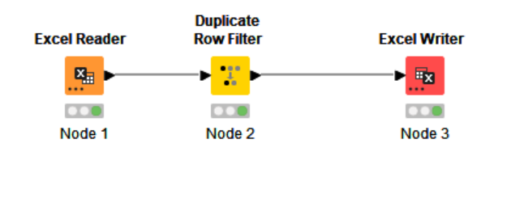
Duplicates are removed using KNIME Model for better performance. Then dataset has 15911 rows and 3 columns.

Slide 6
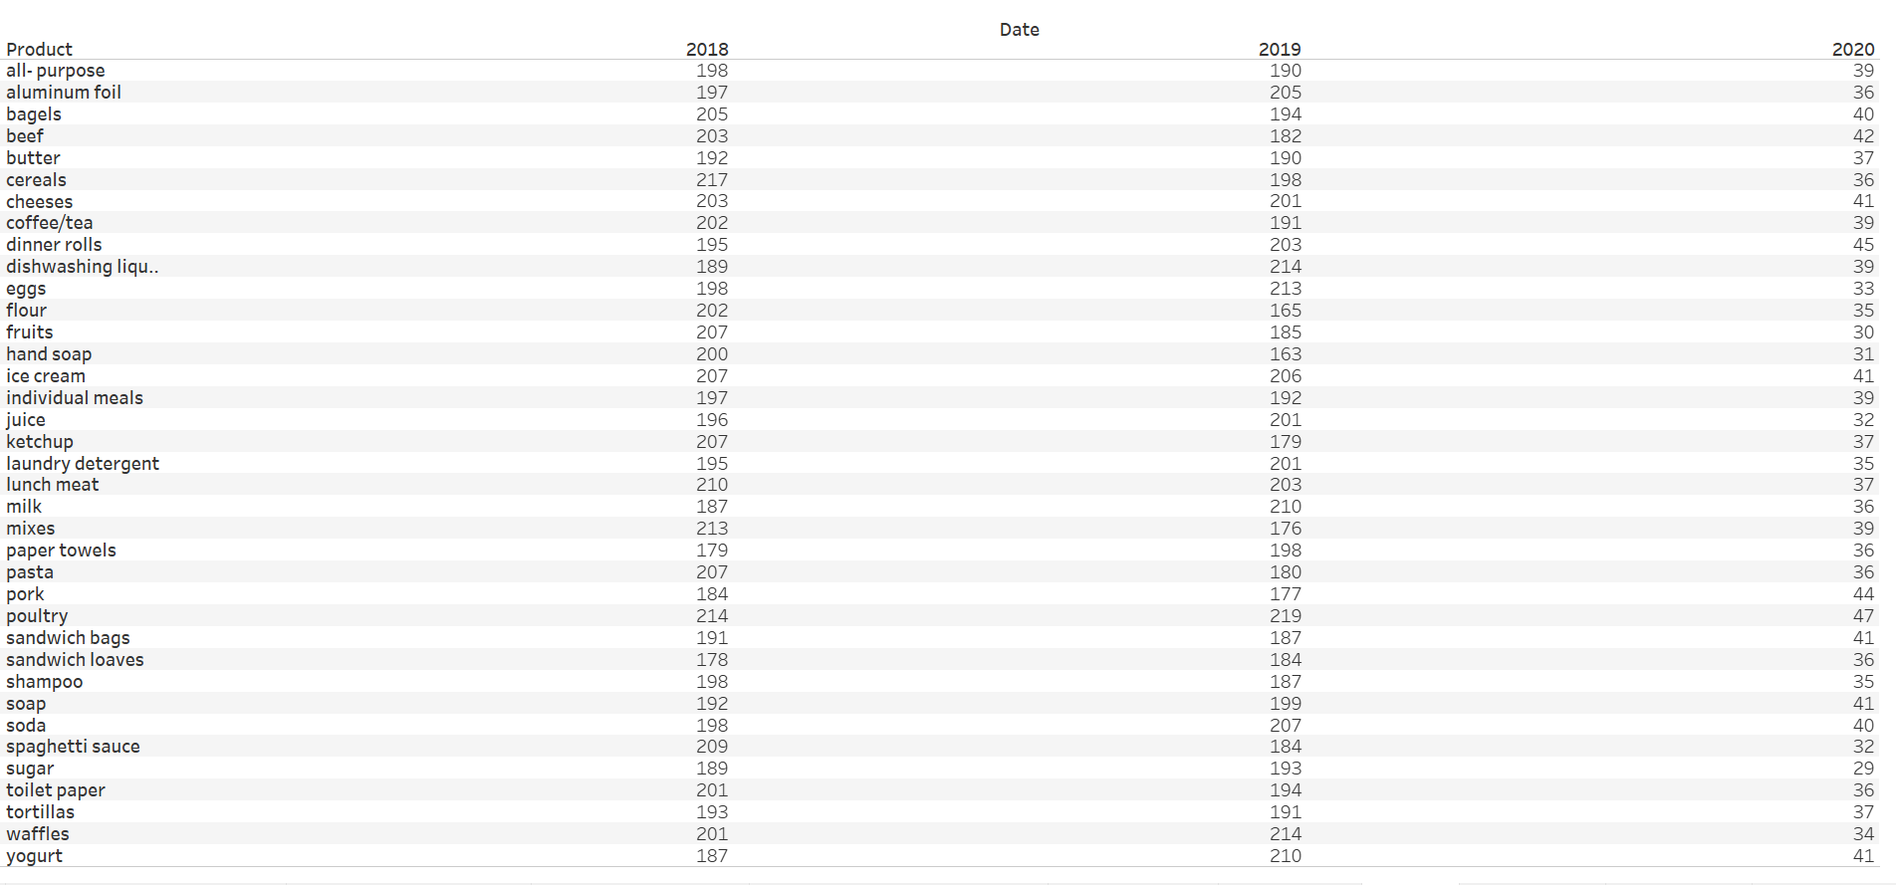
Overall View of Data:

Slide 7
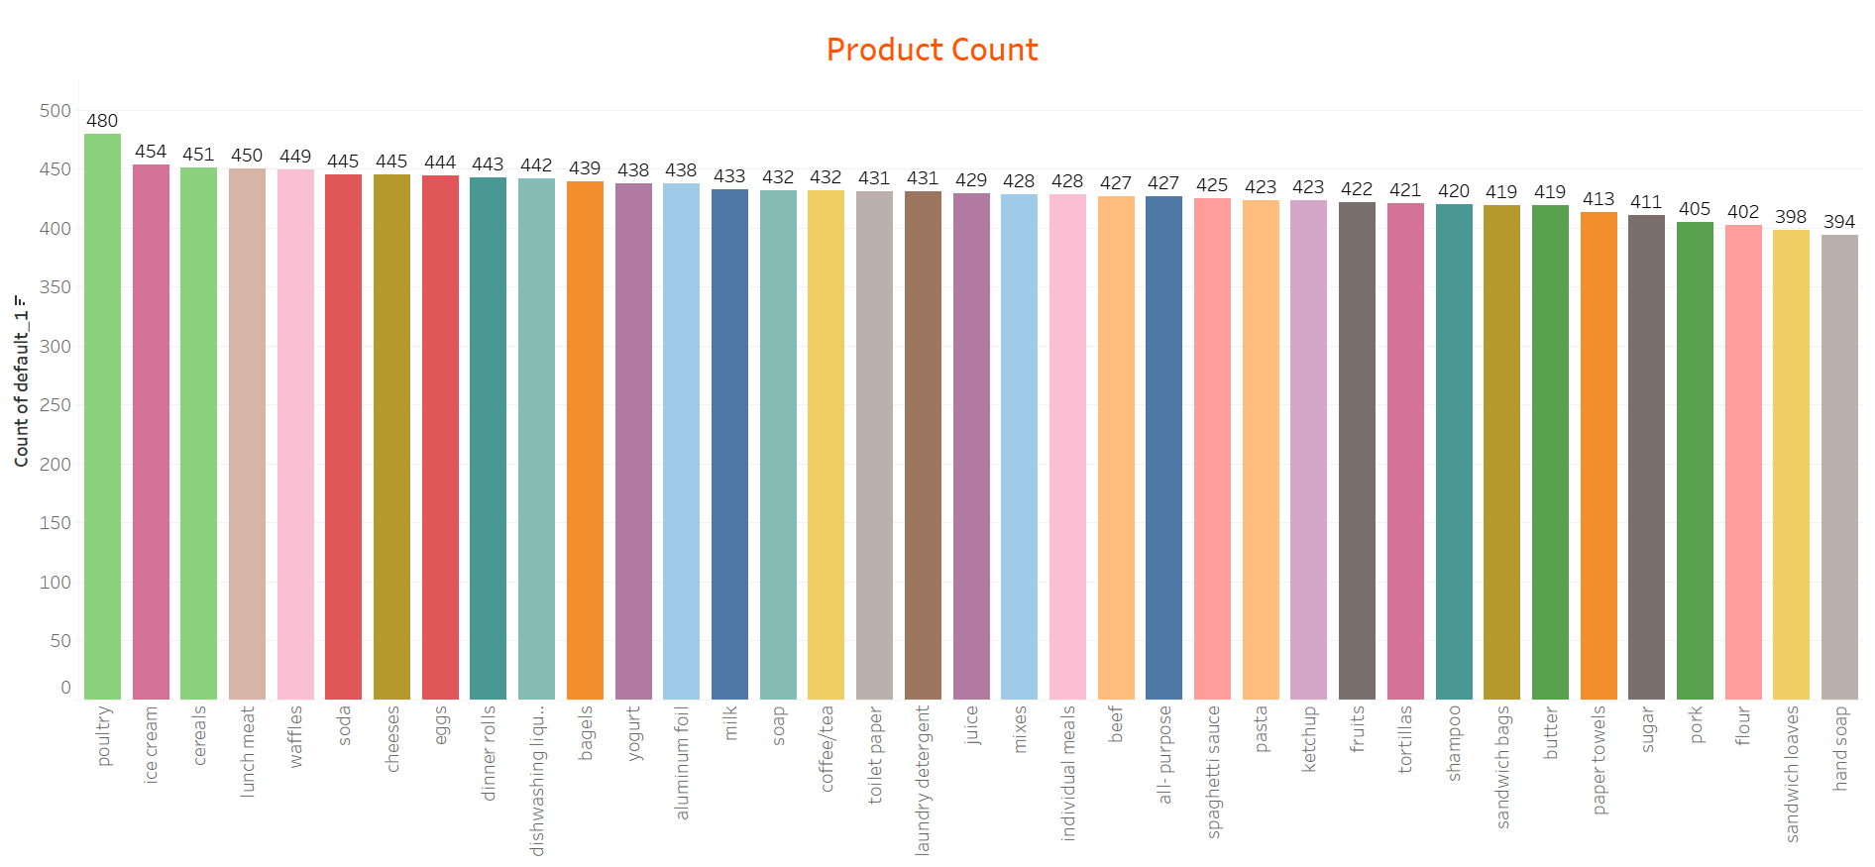
Bivariate Analysis:
In overall product sales, Poultry has higher number of sales over three years followed by
Ice-cream. Hand soap has lower sales followed by sandwich loaves.
.

Slide 8
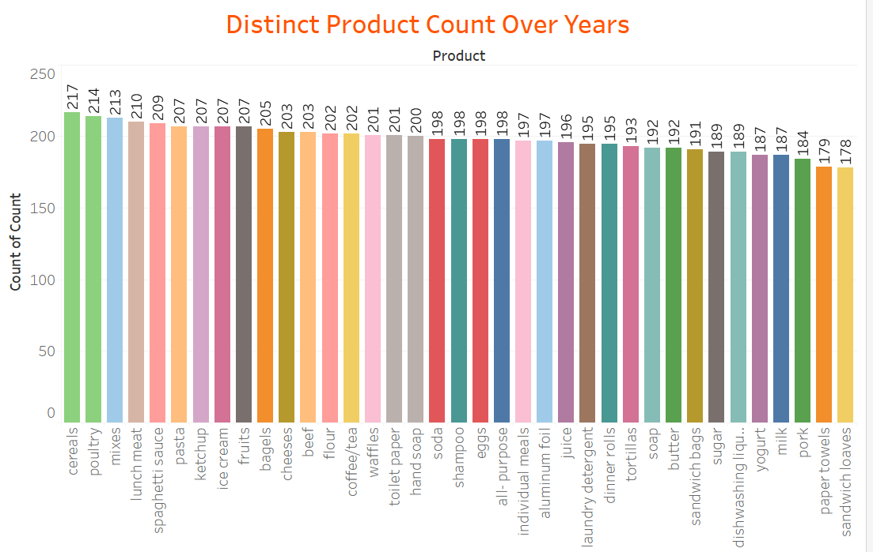
Products sold across 2018:
In year 2018, cereals has higher in sales followed by poultry. Sandwich loaves
has lower in sales.

Slide 9
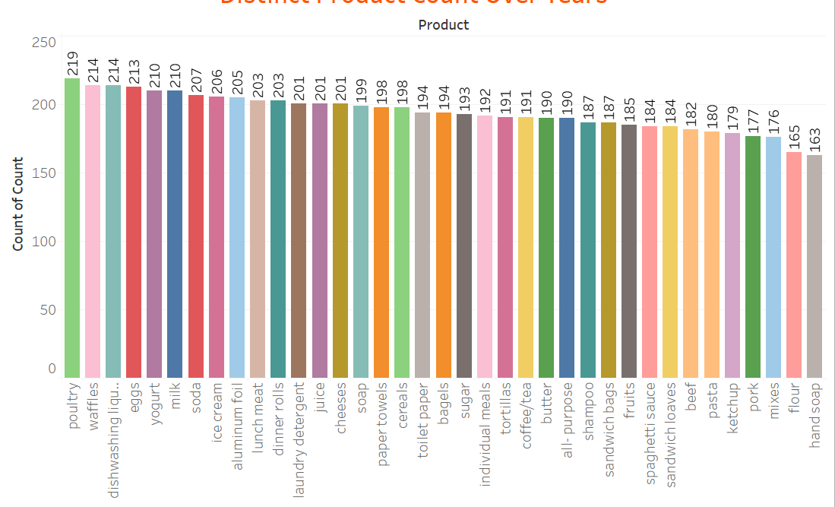
Products sold across 2019:
In year 2019, poultry has higher in sales followed by waffles. Hand soap
has lower in sales.

Slide 10
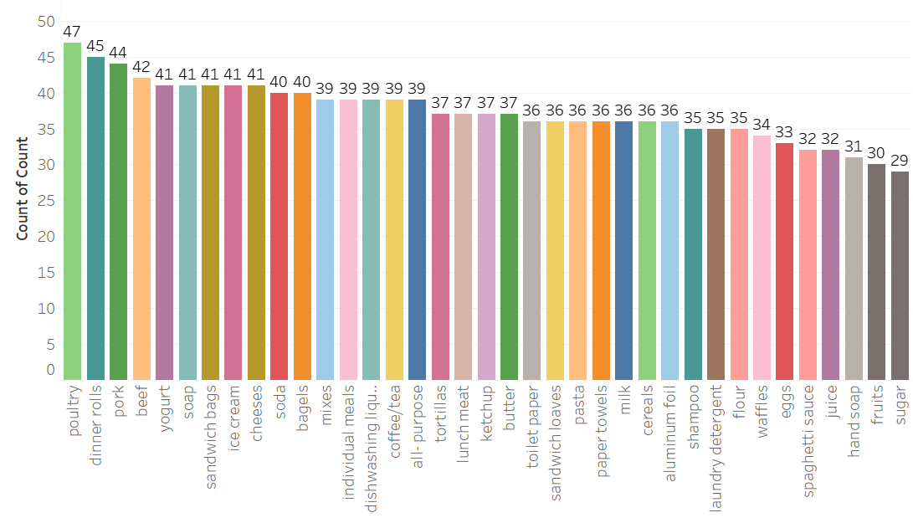
Products sold across 2020:
In year 2020, Poultry has higher in sales followed by dinner rolls. Fruits & sugar
has lower in sales. Year 2020 has only 2 months of data.

Slide 11
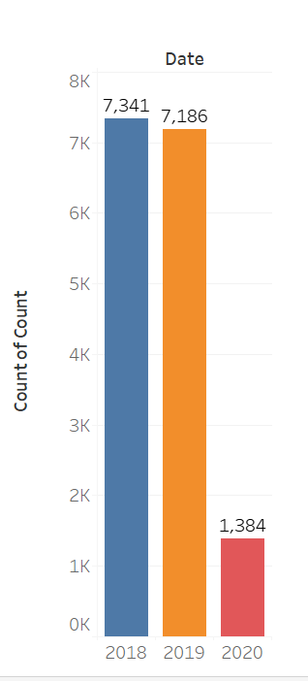
Total Product Sold across Years:
From the chart 2018 has highest number of sales 7341 among the remaining years.
2020 has registered lower in sales(Data has only 2 months )

Slide 12
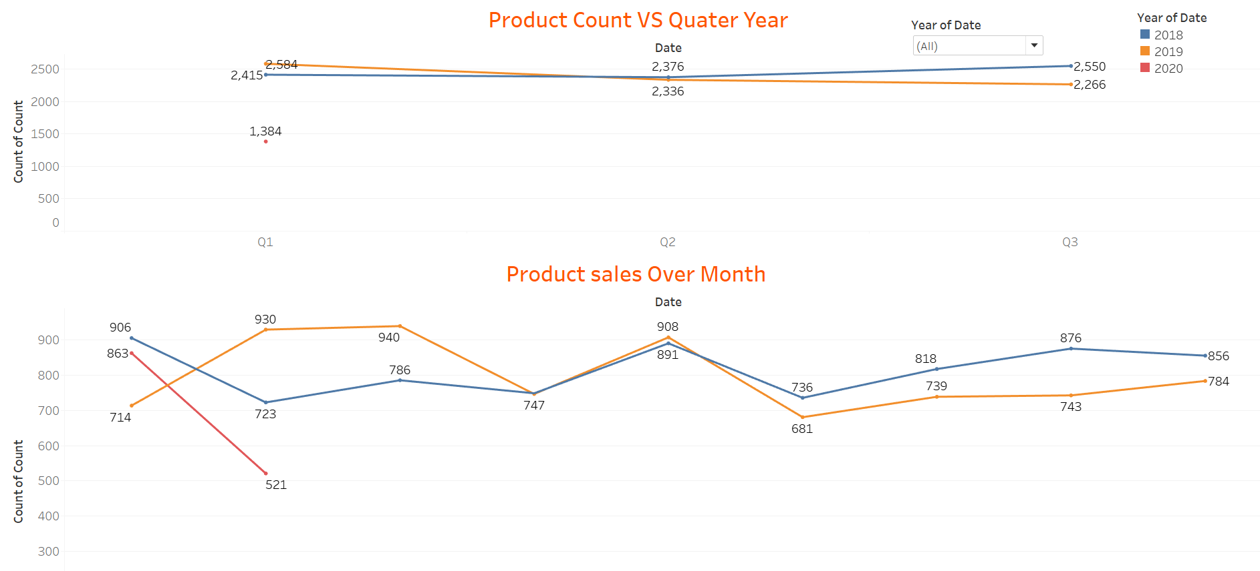
Product Sold over Quarter & Month:
The order trend is decreasing over the years with 2018 has highest sales than 2019 & 2020.
Year 2019 performing well in first quarter than 2018. In third quarter 2019 performing well than 2019
Sales are gradually increasing in mid of the year 2018 & 2019
Sales in 2020 is very low compared to year 2018 & 2029 with respect to two months.

Slide 13
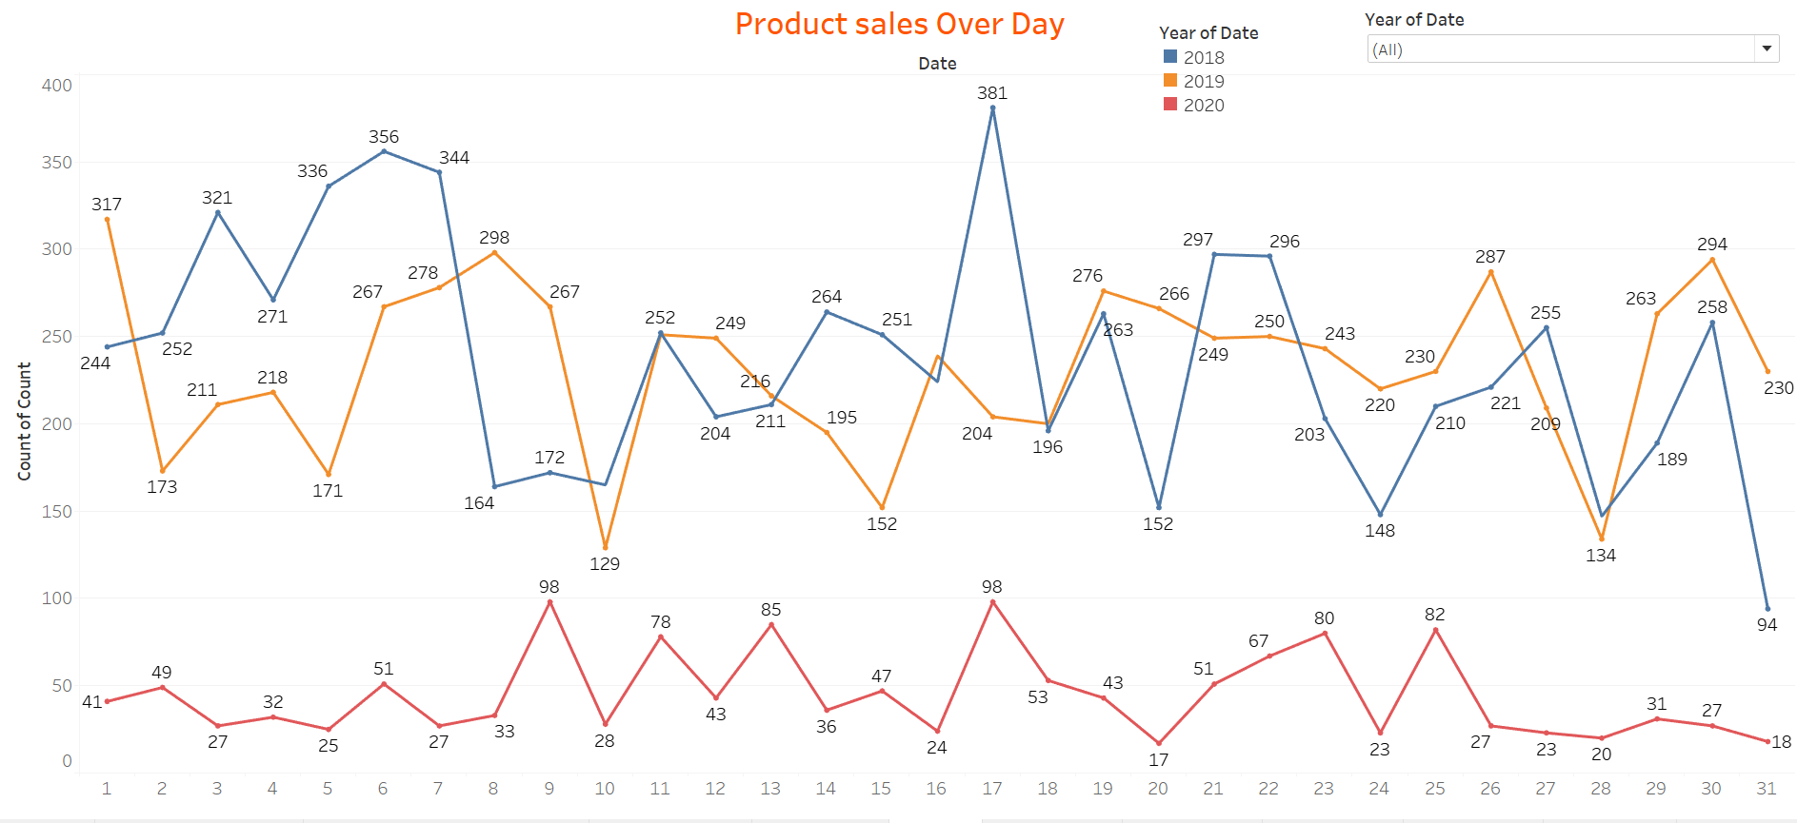
Product Sold over Quarter & Month:
There is no trend and seasonality in the dataset
Days between 12 to 20 in all the years sales has been increased.
For year 2020 sales has been very low in end of the month.

Slide 14
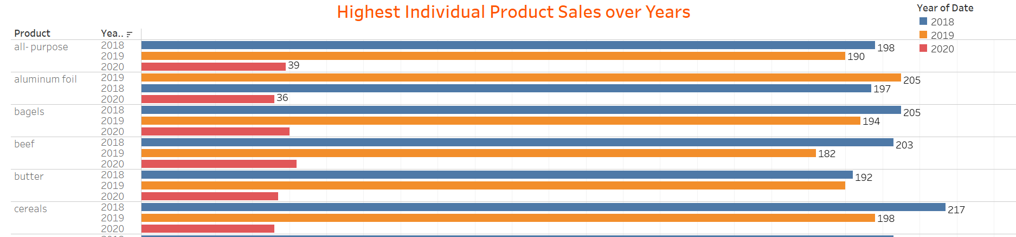
Highest individual product sold:
Highest individual product sold with respect to years, product which has lower in sales need to combine with high sales product to increase the revenue.

Slide 15
Market Basket Analysis:
Market Basket Analysis is one of the key techniques used by large retailers to uncover associations between items.
It works by looking for combinations of items that occur together frequently in transactions.
To put it another way, it allows retailers to identify relationships between the items that people buy.
Association Rules are widely used to analyze retail basket or transaction data, and are intended to identify strong rules discovered in transaction data using measures of interestingness, based on the concept of strong rules.

Slide 16
Associate Rules:
Association Rules are widely used to analyze retail basket or transaction data, and are intended to identify strong rules discovered in transaction data using measures of interestingness, based on the concept of strong rules.
Support is an indication of how frequently the items appear in the data.
Confidence indicates the number of times the if-then statements are found true.
A third metric, called lift, can be used to compare confidence with expected confidence, or how many times an if-then statement is expected to be found true.

Slide 17
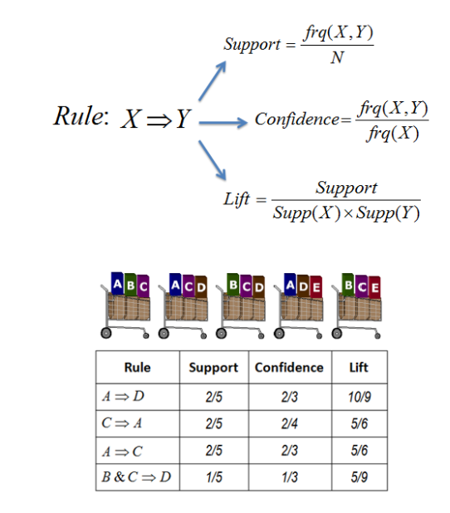
Example of Association Rules:
Assume there are 100 customers
10 of them bought milk, 8 bought butter and 6 bought both of them.
bought milk => bought butter
support = P(Milk & Butter) = 6/100 = 0.06
confidence = support/P(Butter) = 0.06/0.08 = 0.75
lift = confidence/P(Milk) = 0.75/0.10 = 7.5

Slide 18
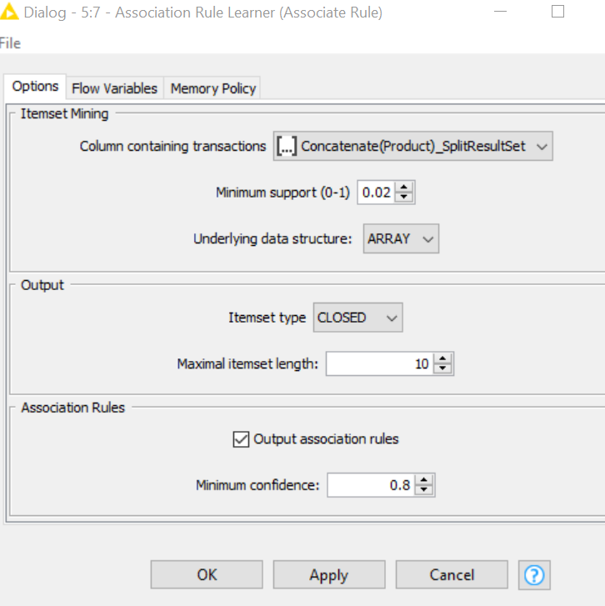
Threshold values of Support and Confidence:
Support of Minimum=0.02
Maximum Item Set Length=10
Minimum Confidence Level=0.08

Slide 19
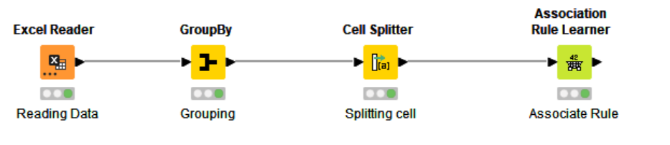
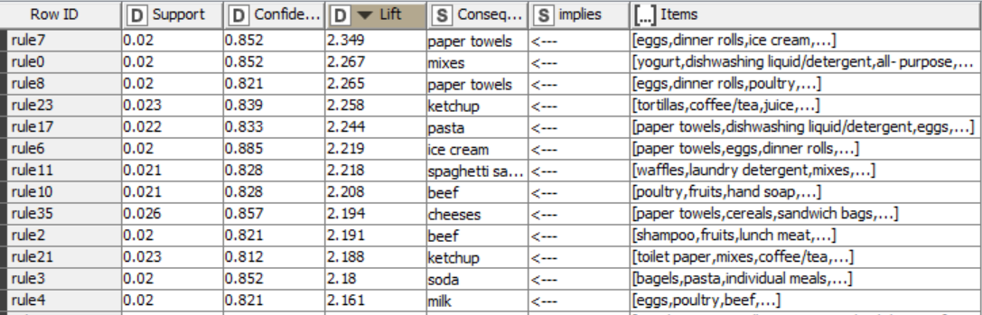
KNIME Workflow:
Top Combo with good confidence level:

Slide 20
Business Recommendations:
We need to think about combos for least sold products to increase the revenue
We can offer some coupons for least selling product to customer, So it will increase the customer frequency.
Repeat customers are beneficial for businesses. Think of ways to increase the frequency of transactions of each customer. If the average customer purchases once a month, consider applying strategies that could make them patronize the business more frequently. For instance, if they end up coming back every week, the company will have more sales and revenue
Social Media advertisement in-store offers are a great way to drive customers to your business. People can easily access their Offer through the Offers bookmark and pull it up on their phone at the till. You can choose to enable a barcode or QR code to scan at checkout to make the whole process quick and easy.

Slide 21
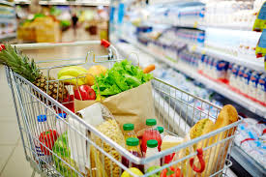
END

